Slide 1
25년 12월 연구미팅자료 진명

Slide 2
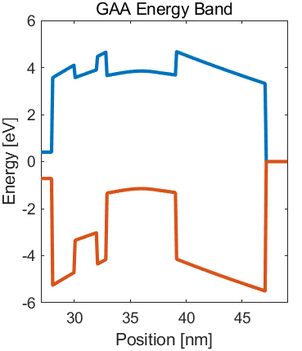

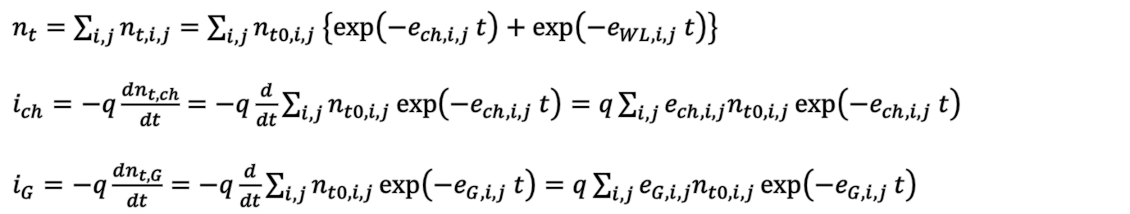



Detrapping from CTN Overview
Electron emission to channel
Electron emission to wordline
$e_{e,ch}=ν_{e,ch}×{\left|TC\right|}_{e,ch}$
$e_{e,WL}=ν_{e,WL}×{\left|TC\right|}_{e,WL}$
Most dominant!
$e_{h,ch}=ν_{h,ch}×{\left|TC\right|}_{h,ch}$
$e_{h,WL}=ν_{h,WL}×{\left|TC\right|}_{h,WL}$
Hole emission to channel
Hole emission to wordline
$n_{t}=\sum_{i, j}{n_{t,i,j}}=\sum_{i, j}{n_{t0,i,j} \left\{\exp\left(−e_{ch,i,j} t\right)+\exp\left(−e_{WL,i,j} t\right)\right\}}$
$i_{ch}=−q\frac{dn_{t, ch}}{dt}=−q\frac{d}{dt}\sum_{i, j}{n_{t0,i,j}\exp\left(−e_{ch,i,j} t\right)}=q\sum_{i, j}{e_{ch,i,j}n_{t0,i,j}\exp\left(−e_{ch,i,j} t\right)}$
$i_{G}=−q\frac{dn_{t, G}}{dt}=−q\frac{d}{dt}\sum_{i, j}{n_{t0,i,j}\exp\left(−e_{G,i,j} t\right)}=q\sum_{i, j}{e_{G,i,j}n_{t0,i,j}\exp\left(−e_{G,i,j} t\right)}$
=> Modeling by time transient & leakage current

Slide 3
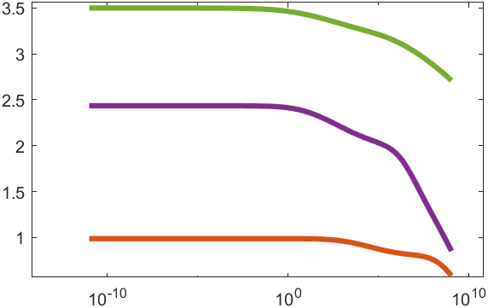
Detrapping from CTN Overview
Simulation flowchart
Vth Prediction after given time
Cell Information Initialize
Location
Trap depth
N_{e,t}
N_{h,t}
e_{e,ch}
e_{e,WL}
e_{h,ch}
e_{h,WL}
ΔV_{th}
Retention Time [s]
Exponential Decay Prediction by Time constant
$n_{t}=\sum_{i, j}{n_{t,i,j}}=\sum_{i, j}{n_{t0,i,j} \left\{\exp\left(−e_{ch,i,j} t\right)+\exp\left(−e_{WL,i,j} t\right)\right\}}$

Slide 4
Detrapping Transient & TCAD Fitting
Ongoing process for process variations – well match
Calibration condition
2/2/1/6/8 BETOX
Shallow Trap: Gaussian
Deep Trap: exact
However, for simplicity of the research >> ONO (5/6/8) Structure will be used for discussion

Slide 5
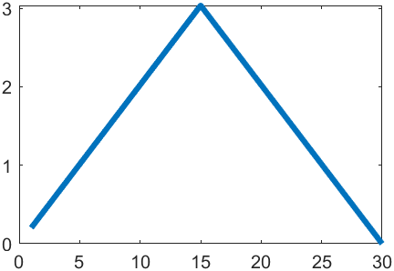
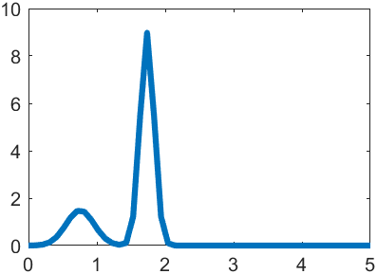
Detrapping Characteristic Variations
Variation Settings
CTN trapped electron profile
Shallow/Deep trap profile
Process Variation
Shallow Trap:
narrow distribution, fast
Initial V_{th}
Deep Trap:
wide distribution, slow
Initial V_{th}

Slide 6
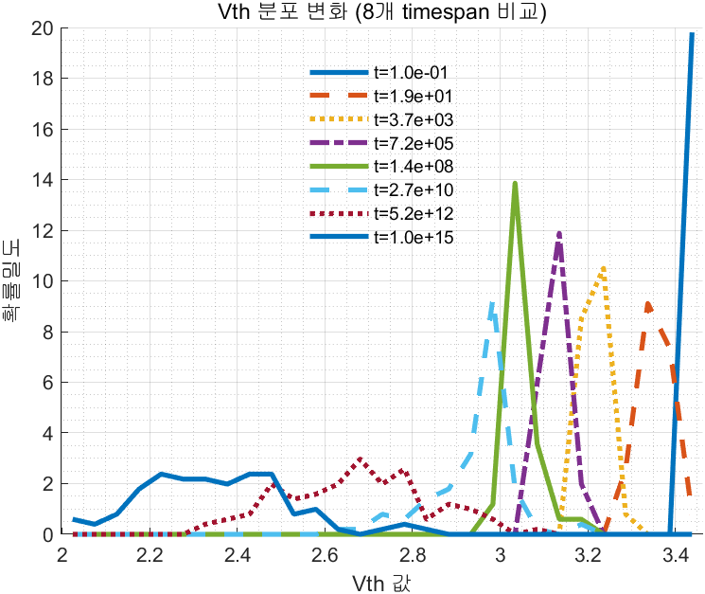
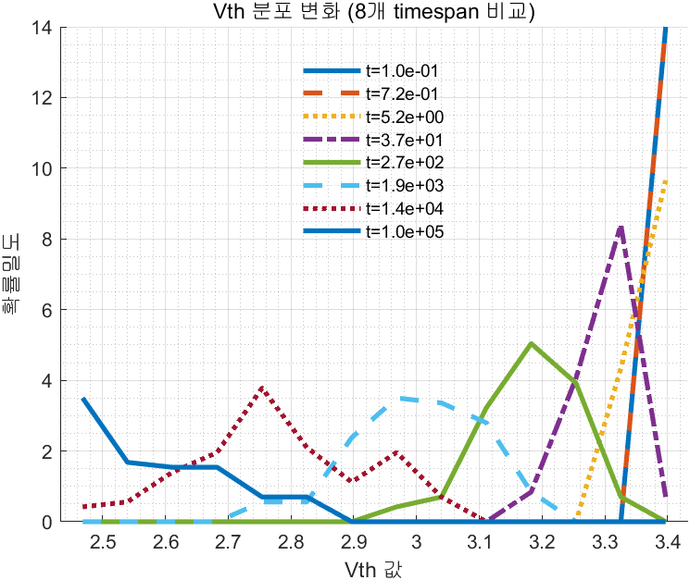
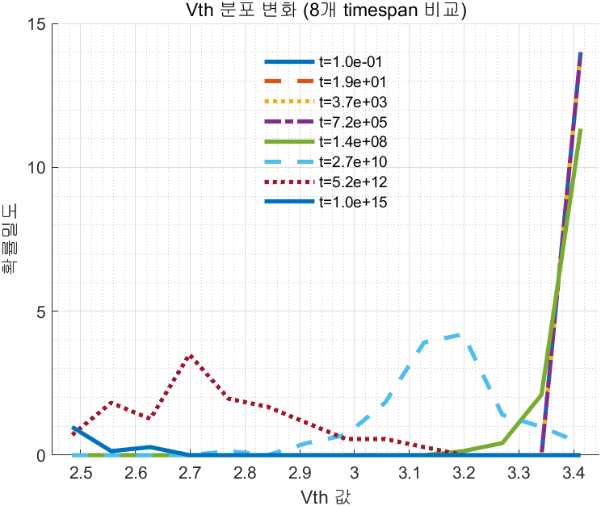
Detrapping Characteristic Variations
Only Shallow
(fast, narrow)
Shallow trap retention variation dominant
Only Deep
(slow, wide)
Deep trap retention variation dominant
Deep trap retention distribution widening starts

